Slide 1




ROAD LANE LINE DETECTION
GUIDE
Mr. K. Sreenivasa Rao
Assistant Professor
Department of CSE-AIML&IoT
BATCH - 11
20071A6916 - D. Vishnu Siddartha Reddy
20071A6930 - K. Yashwanth Sai Krishna
20071A6940 - MKM Nawaz
20071A6944 - P. Sathwik Goud

Slide 2
Abstract
Introduction
Literature Survey
Existing System
System Requirements
a. Functional Requirements
b. Non-Functional Requirements
6. Proposed System
7. System Architecture
8. UML Diagrams
9. Implemenation
10. Testing
11. Result
12. Conclusion
13. Future scope
AGENDA

Slide 3
ABSTRACT
The main objective of this project is to automatically detect and track the lane markings on the road in real time, using image processing techniques.
It provides an accurate and reliable system for detecting and tracking the lane markings on the road.
A lane detection system is an important part of many technologically advanced transportation systems

Slide 4
INTRODUCTION
The technique involves processing images or video frames captured by a camera mounted on a vehicle and identifying the white or yellow lines marking the lanes on the road.
The algorithm used in this work aims to recognize lane markings on the road by feeding the system a video of the road as an input using computer vision technology, with the primary goal of lowering the number of accidents

Slide 5
LITERATURE SURVEY
S.No | TITLE OF THE PAPER | METHODS/APPROACH | PUBLISHED YEAR
1 | ROAD LANE LINE DETECTION USING OPENCV | OpenCV | 2022
2 | Road Lane-Lines Detection in Real-Time for Advanced Driving Assistance Systems | Computer Vision Algorithm | 2018
3 | Lane Line Detection based on Machine Vision | Machine Vision | 2022
4 | Lane-line Detection Algorithm for Complex Road Based on OpenCV | OpenCV | 2019

Slide 6
S.No | TITLE OF THE PAPER | METHODS/APPROACH | PUBLISHED YEAR
5 | Lane Line Detection Based On YOLOv4 | Yolov4 method | 2021
6 | Lane Line Detection Optimization Algorithm based on Improved Hough Transform and R-least Squares with Dual Removal | Hough Transform and RLSDR method | 2019
7 | Research on Lane Detection and Tracking Algorithm Based on Improved Hough Transform | Hough Transf | 2022

Slide 7
S.No | TITLE OF THE PAPER | METHODS/APPROACH | PUBLISHED YEAR
8 | Simple road lane line detection algorithm | Canny Edge detection | 2014
9 | An Efficient Method of Lane Detection and Tracking for Highway Safety | Canny Edge Algorithm | 2019
10 | Research on Real-Time Lane Line Detection Technology Based on Machine Vision | Machine Vision | 2010
11 | Research on Real-Time Lane Line Detection Technology Based on Machine Vision | Bilateral Filter and SAGC | 2021

Slide 8
S.No | TITLE OF THE PAPER | METHODS/APPROACH | PUBLISHED YEAR
12 | Simple road lanVision-based lane line detection for autonomous vehicle navigation and guidance e line detection algorithm | Ridge detector and sequential RANSAC | 2015
13 | Lane line detection by using Hough Transform | Hough Transform | 2018
14 | Lane line detection in real time based on morphological operations for driver assistance system | Hough Transform | 2017

Slide 9
EXISTING SYSTEM
All the existing systems only detect the white lane on the road.
A drawback is that the existing system has a difficult goal to fulfill because of the varying road conditions that a person encounters, particularly while driving at night or in the daytime.
Another drawback noticed is that most of the systems did not detect the surrounding objects of the vehicle (like a car or a bike or any object coming against the vehicle.)

Slide 10
PROPOSED SYSTEM
The algorithm used in this work aims to recognize lane markings on the road by feeding the system a video of the road as an input using computer vision technology, with the primary goal of lowering the number of accidents.
In order to obtain a very high recognition rate, we successively carry on color detection and edge detection to the lane.

Slide 11
In addition, our system detects the object which is in front of the vehicle.
To upgrade this system, we can also calculate the distance of the other vehicle which is in front of our vehicle.
Furthermore, the driver's performance may be tracked, and Road Transportation Offices can use the system to monitor and report driver irresponsibility and lack of attention on the roadways.

Slide 12
SYSTEM REQUIREMENTS

Slide 13
FUNCTIONAL REQUIREMENTS
Image Acquisition: The system should be able to acquire an image of the road using a camera.
Pre-processing: The acquired image needs to be pre-processed before applying lane detection algorithms. Pre-processing includes resizing, converting color spaces, applying filters, etc.
Lane detection algorithms: OpenCV provides a variety of lane detection algorithms such as Hough Transform, Canny Edge Detection, and Sobel Edge Detection. The system should implement

Slide 14
FUNCTIONAL REQUIREMENTS
at least one of these algorithms to detect lane lines.
Lane marking: Once the lane lines are detected, the system should mark the detected lane lines with a specific color or thickness.
Lane tracking: The system should be able to track the lane lines in real time, even if there are small changes in the road surface or lighting conditions.

Slide 15
NON - FUNCTIONAL REQUIREMENTS
Performance: The system should be able to process images in real time with a high frame rate and minimal delay.
Accuracy: Lane detection should be accurate and reliable, providing precise lane markings and vehicle position tracking.
Scalability: The system should be able to handle different types of vehicles and road sizes, and should be scalable to handle a large number of concurrent users.
Robustness: The system should be robust to different lighting conditions, road surface conditions, and weather conditions.

Slide 16
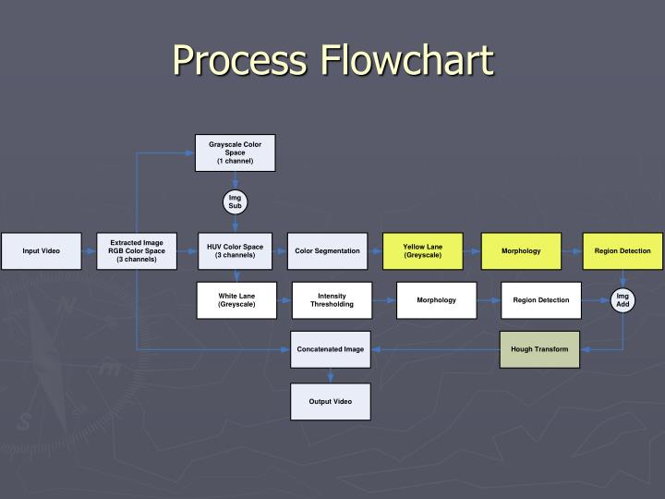
SYSTEM ARCHITECTURE

Slide 17
UML
DIAGRAMS

Slide 18
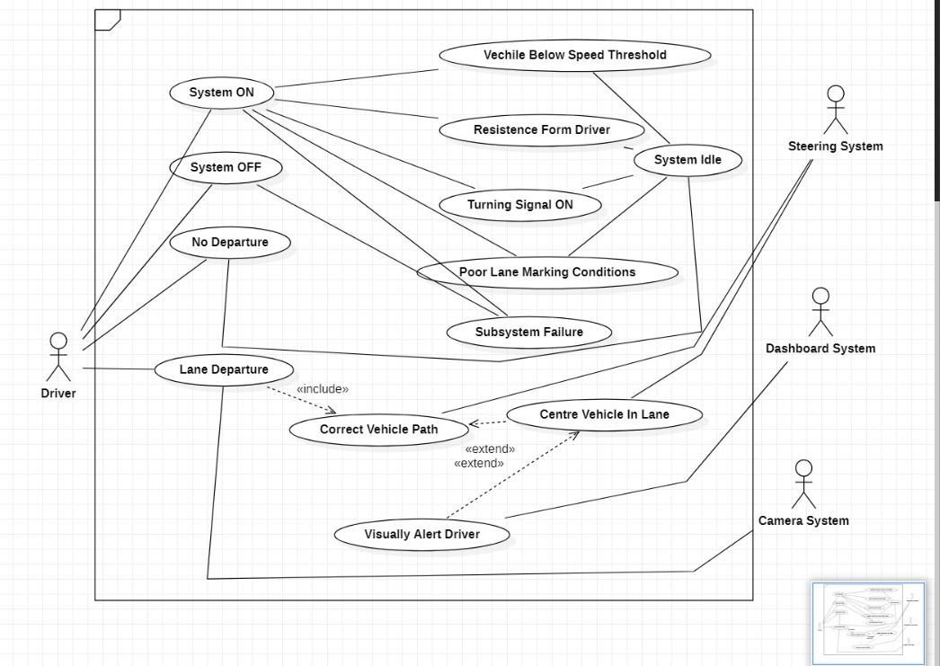
USECASE DIAGRAM

Slide 19
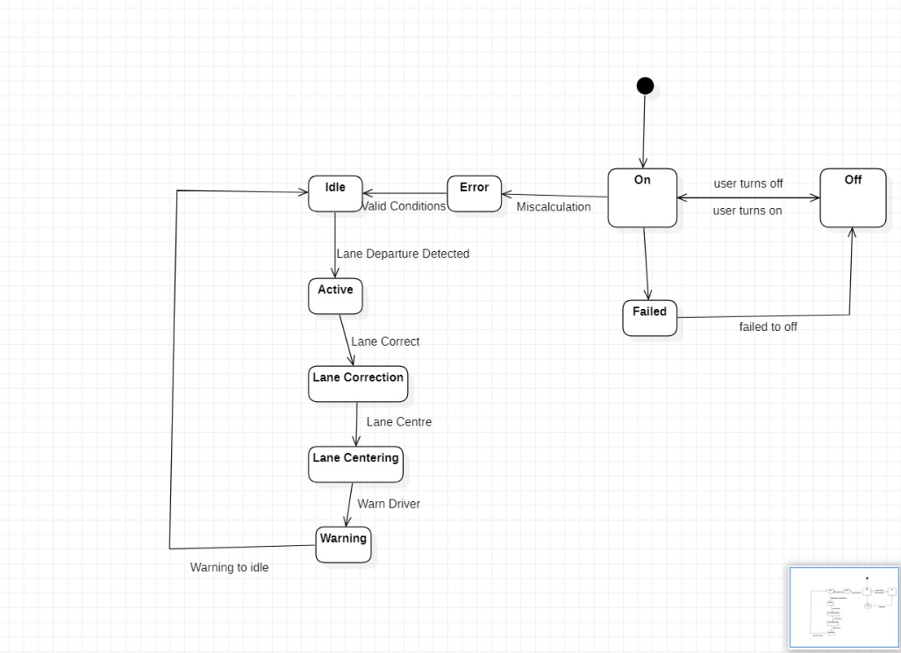
STATE
DIAGRAM

Slide 20
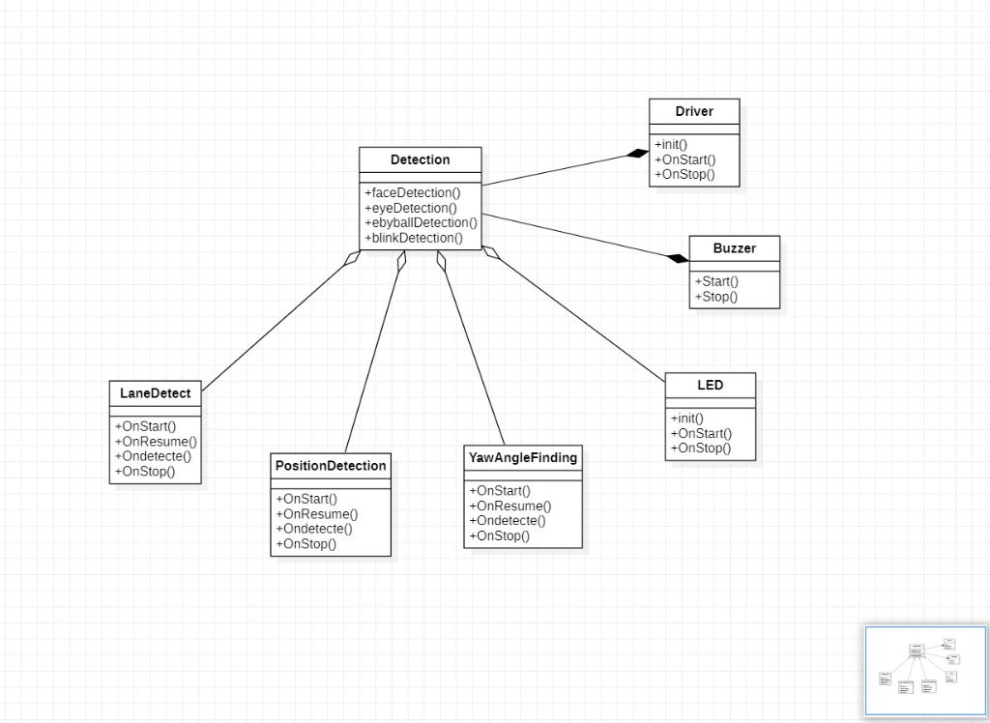
CLASS
DIAGRAM

Slide 21
IMPLEMENTATION

Slide 22

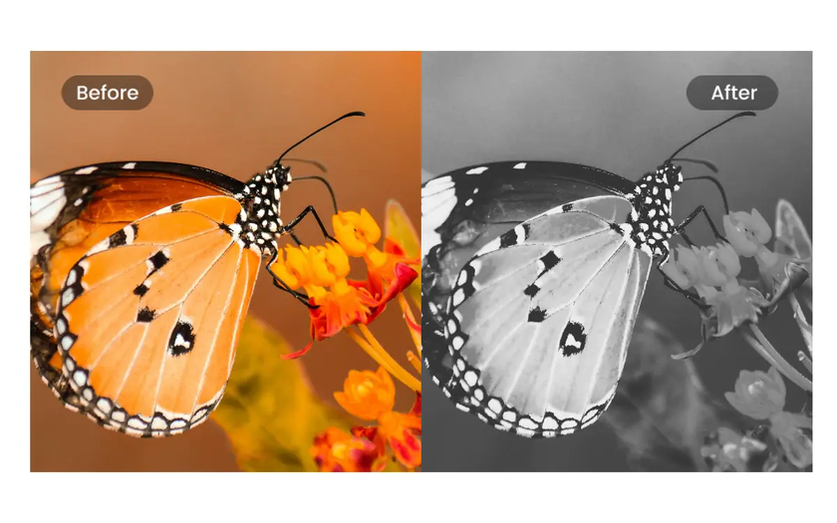

STEP-1 >> GRAYSCALE
Convert the original image into grayscale
gray = cv2.cvtColor ( lane_image, cv2.COLOR_RGB2GRAY )

Slide 23

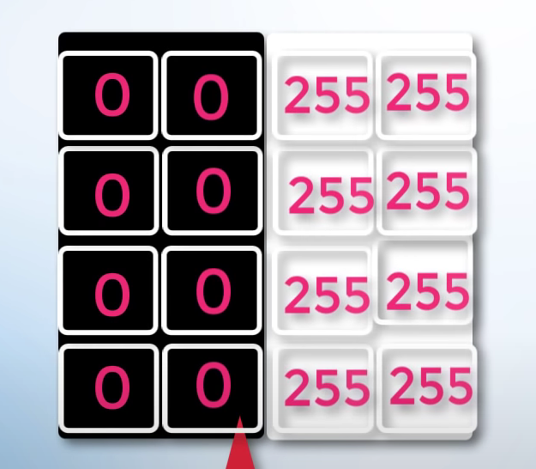

Slide 24


Slide 25
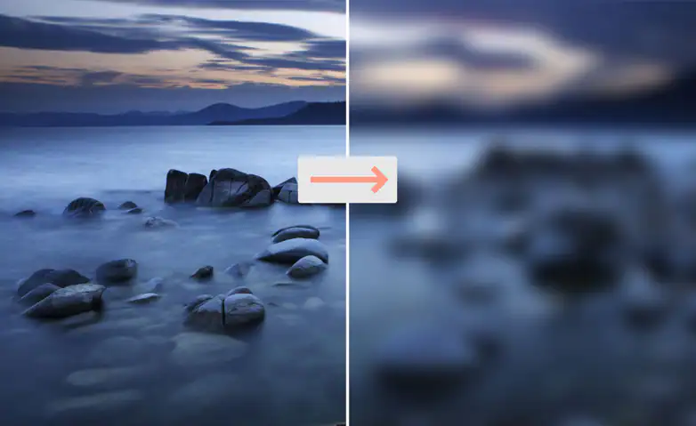
STEP-2 >> GAUSSIAN BLUR
Blurring the image
blur = cv2.GaussianBlur(gray, (5, 5), 0)

Slide 26
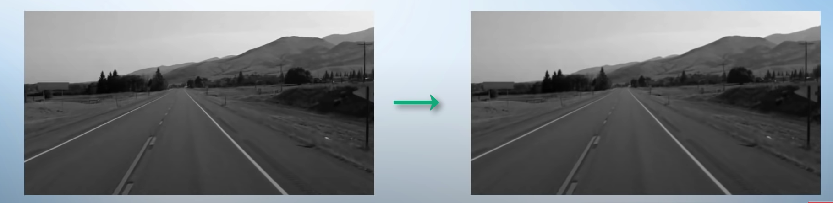

Slide 27

STEP-3 >> CANNY EDGE DETECTION
Detecting the edges
cv2.Canny( image, low_threshold, high_threshold )

Slide 28
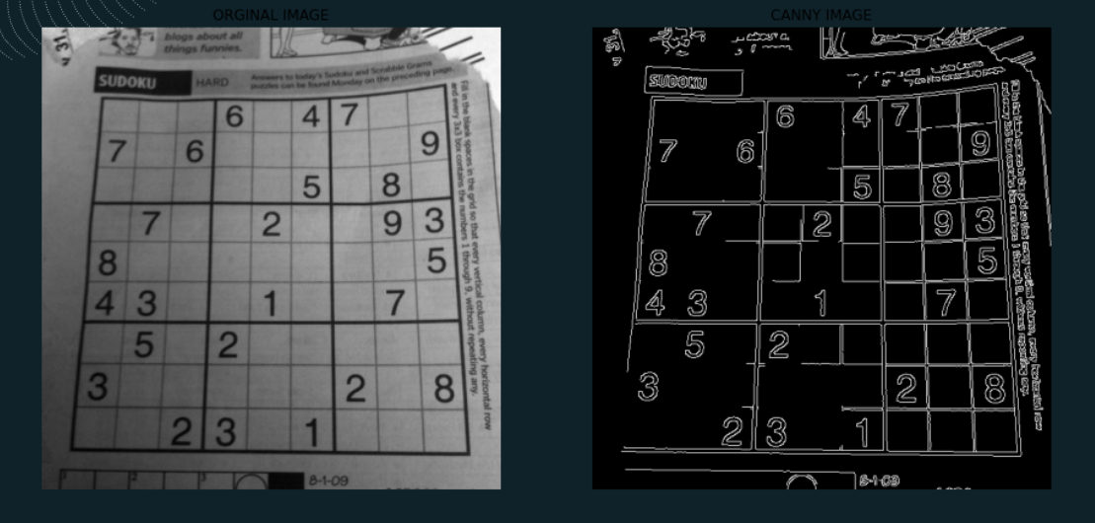

Slide 29
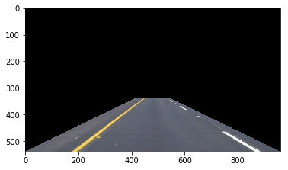
STEP-4 >> REGION OF INTEREST
Required region is considered and and canny detection method is applied to it.
mahplotlib (plt)

Slide 30
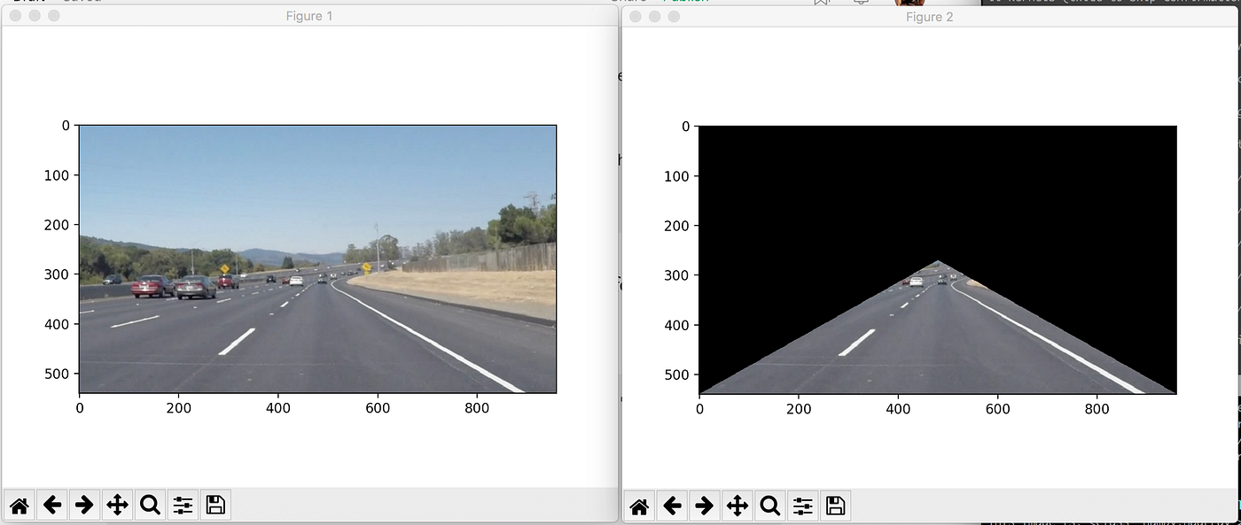

Slide 31
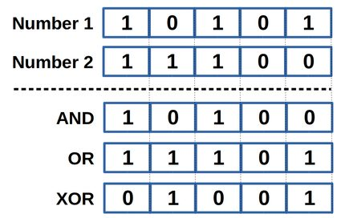
STEP-5 >> BITWISE AND
Performing bitwise AND operation to the canny edge detected image and region of intrest image.
masked_image = cv2.bitwise_and ( image, mask )

Slide 32
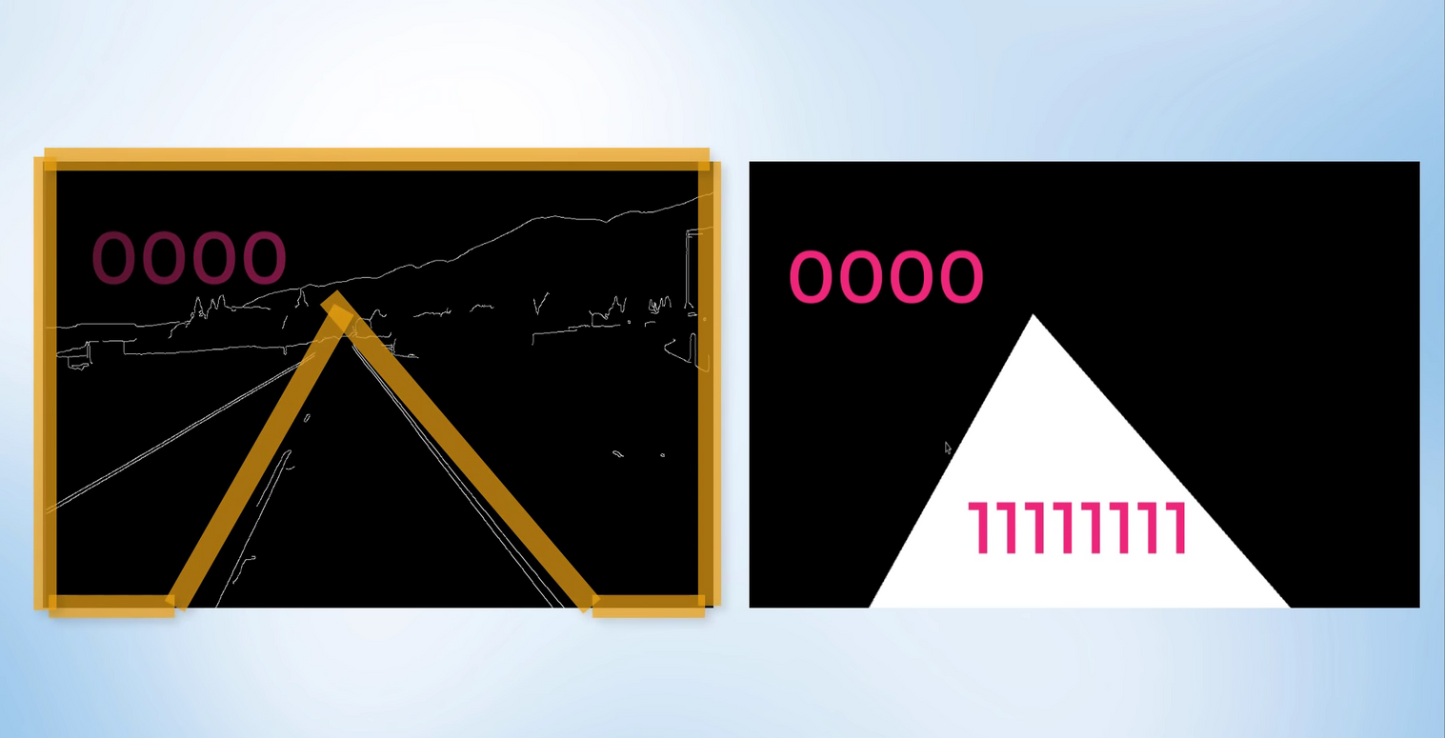

Slide 33
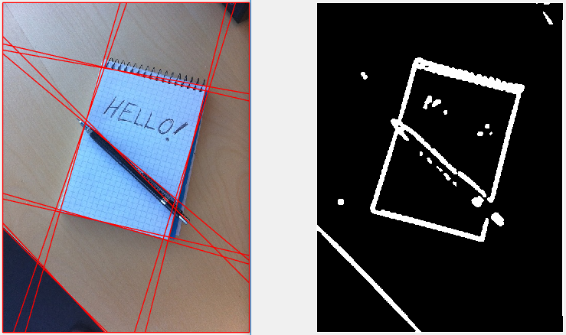
STEP-6 >> HOUGH TRANSFORM
Hough Transform is a popular technique to detect any shape, if you can represent that shape in mathematical form. It can detect the shape even if it is broken or distorted a little bit.

Slide 34
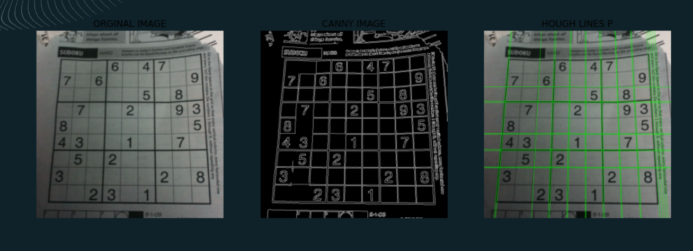

Slide 35
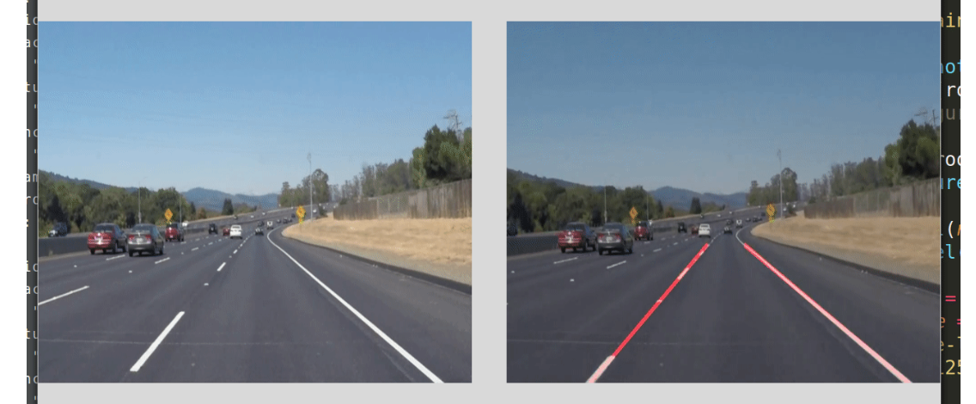

Slide 36
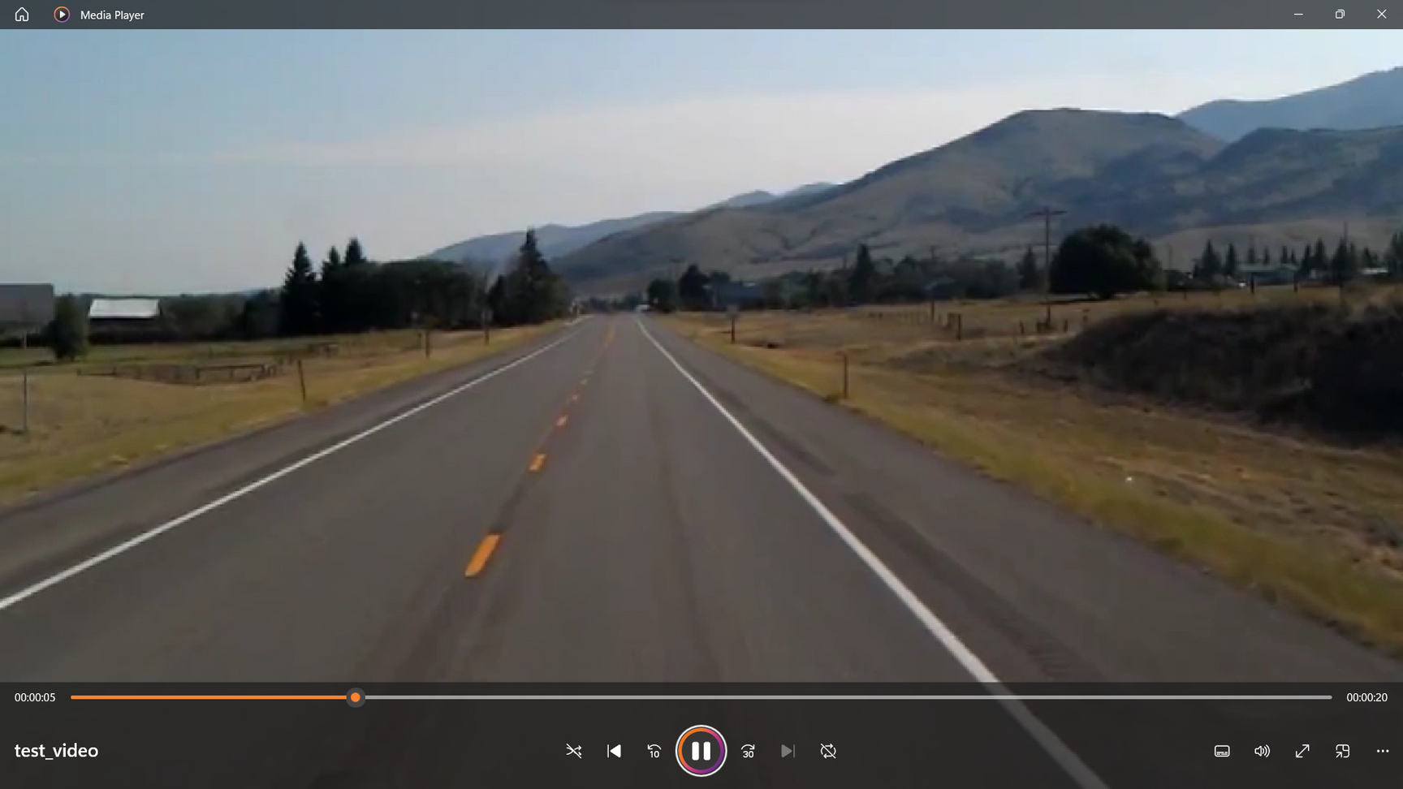
TESTING

Slide 37
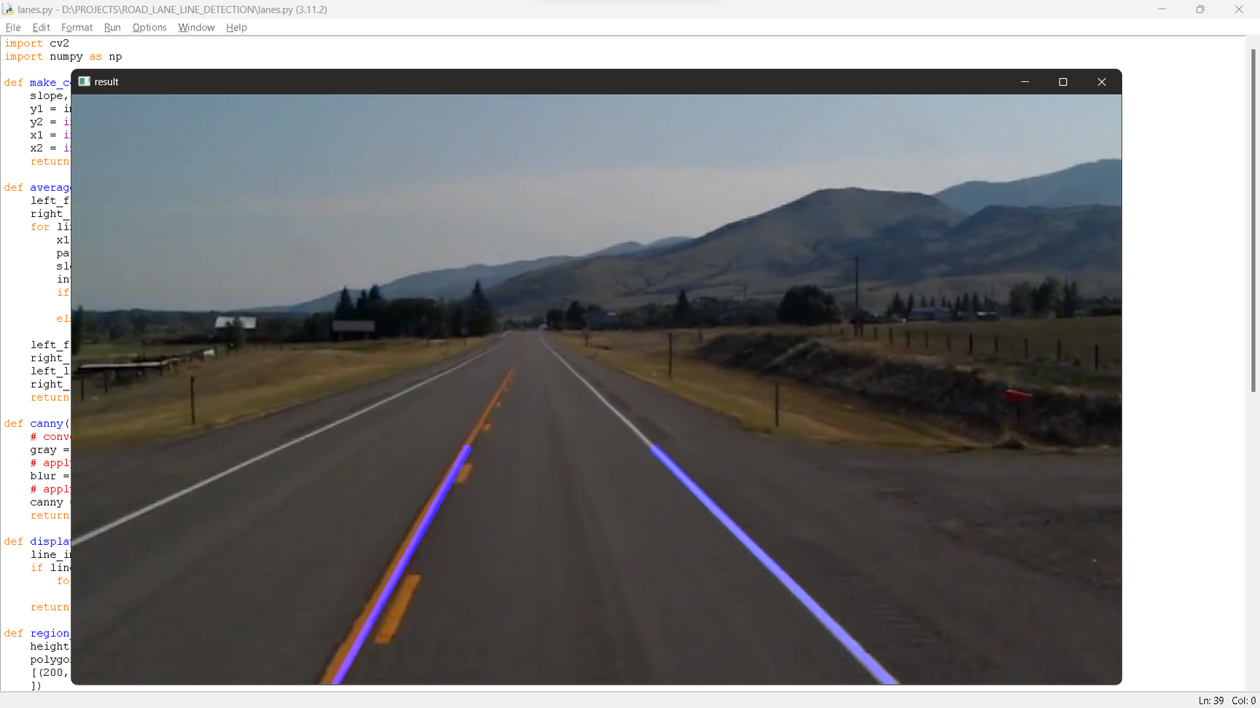
RESULT

Slide 38
CONCLUSION
All the existing systems only detect the white lane on the road.
A drawback is that the existing system has a difficult goal to fulfill because of the varying road conditions that a person encounters, particularly while driving at night or in the daytime.
Another drawback noticed is that most of the systems did not detect the surrounding objects of the vehicle (like a car or a bike or any object coming against the vehicle.)

Slide 39
FUTURE SCOPE
Advanced lane line tracking: One direction for future development is the improvement of lane line tracking in more complex scenarios, such as curved roads, intersections, and changing lighting conditions.
Lane departure warning systems: Lane departure warning systems are already in use in some vehicles, but there is potential to improve their accuracy and reliability.
Autonomous driving: Road lane line detection is an essential component of autonomous driving systems. In the future, it is likely that lane detection algorithms will become even more sophisticated and accurate.

Slide 40
BIBILOGRAPHY
S. Zhang and L. Zhang, "A Survey of Recent Advances in Lane Detection and Departure Warning Systems," IEEE Transactions on Intelligent Transportation Systems, vol. 18, no. 10, pp. 2687-2705, Oct. 2017.
R. Unnikrishnan and V. S. Gandhi, "A Review of Lane Detection Algorithms for Autonomous Vehicles," International Journal of Advanced Research in Computer and Communication Engineering, vol. 8, no. 1, pp. 171-175, Jan. 2019.
P. S. Saha, A. K. Maiti, and S. K. Bandyopadhyay, "A Review of Lane Detection and Departure Warning System," in Proceedings of the 2016 IEEE International Conference on Advanced Networks and Telecommunications Systems (ANTS), Dec. 2016, pp. 1-6.

Slide 41
BIBILOGRAPHY
Y. Wang and S. Zhang, "A Survey of Lane Detection and Tracking Techniques," IEEE Intelligent Vehicles Symposium Proceedings, pp. 1484-1489, June 2013.
OpenCV documentation and tutorials, which include examples and tutorials on road lane line detection using OpenCV and Python.
Code repositories and blogs such as GitHub and Medium, which provide code examples and step-by-step tutorials for implementing road lane line detection algorithms.

Slide 42
THANK YOU

